Slide 1
RULERS
Prime minister : Ahmed Mohammed
Benevolent rulers: Khayal Alsaie + Sam Alfassi

Slide 2
The Parson
Physical appearance - direct characterization
Personality – indirect characterization
Job today

Slide 3
Cont. Personality
(Direct)
He walked with a stave(staff)
Active
  He used to run to London to earn easy bread.

Slide 4
Personality
Poor
Rich in holy thoughts and work
Holy minded man and virtuous
Generous and kind
Always keeps his limits for himself and when anyone asks him for help, he helps them.

Slide 5
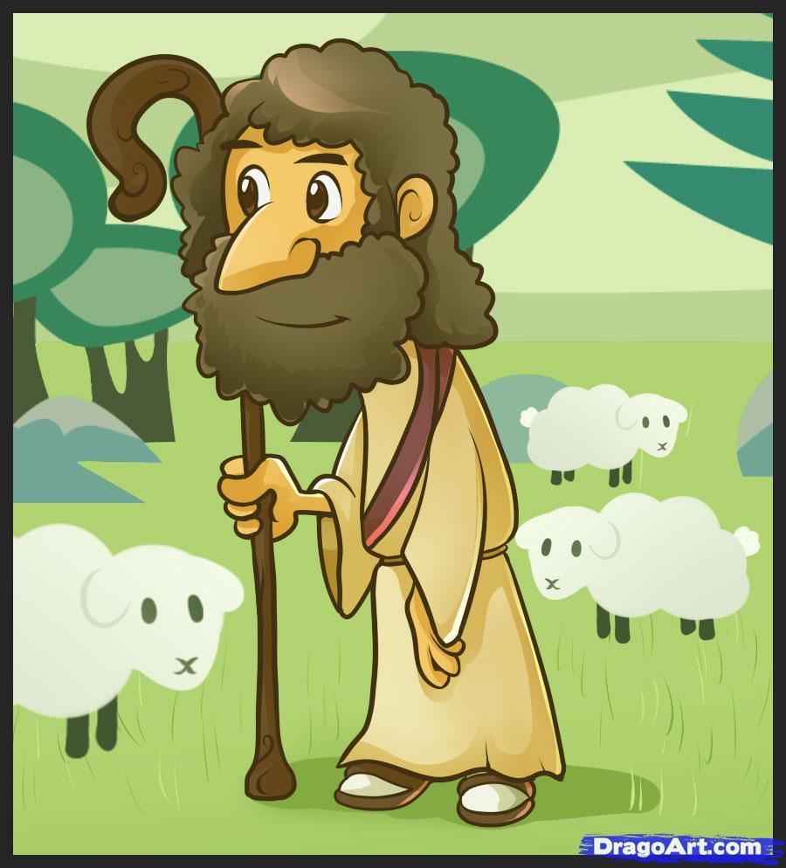
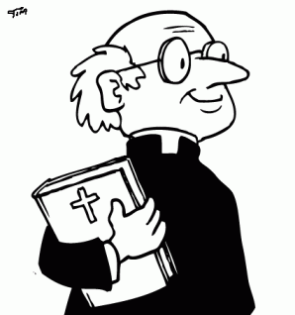
Job today
Parish Priest
Shepherd

Slide 6
conclusion
Being as shepherd old days was actually being in good job that can get you a lot of sources of food like mild, meat or skin. But now, working as a shepherd, it won’t give you enough money for living.
In old days, being a parish priest was a good job, because most of the people respect you, today it is still a good job and you get more respect than any other priest got before. As we can see the Vatican nowadays, whenever the priest comes out to say his words a lot of cheers comes on people’s face and also signs of respect.

